Slide 1

Wireless Networking
Ambuj Varshney
Assistant Professor, National University of Singapore
Wireless, Embedded Intelligence, Sensing, and Emerging Technologies Group
ambujv@nus.edu.sg

Slide 2
Administration and Course Logistics

Slide 3
Course Project
Project: Apply a number of different concepts and design a working system
Neighbour discovery
Proximity detection
Interfacing sensors
Opportunistic networking
Deadline: 21st April 2023/ With penalty (10%) 28th April 2023
Should be done in a group. Need to submit only one report per group.
Notes:
++ We may all have heard of the term Internet of Things. So how are these wireless embedded systems related to the Internet of Things: Today, IoT includes a broad class of devices, including powerful platforms such as smartphones. However, it also includes more resource-constrained devices and what we call Wireless Embedded Systems, and in fact, I consider it to be one of the essential parts of the IoT ecosystem.
++ These are platforms equipped with a radio transceiver, sensor, microcontroller, and some form of energy storage. These platforms also often form a network, and sensor network as it is called has been an active area of research for the past two decades.
++ The research community has also developed wireless embedded platforms which we may know about, and these include: CMUCAM, which is an image sensor platform developed at Carnegie Mellon University, or Permamote is long life sensor platform from the lab I am associated with at UC Berkeley or Lorea which is a long-range backscatter platform that I had developed as part of my doctoral dissertation at Uppsala University. All of these are an example of Wireless Embedded Systems.

Slide 4
Examination
Two hours long, Paper-Pen (Hard Copy)
Drafted: 5 questions, 40 marks overall
Open book examination
Lecture notes, slides, any printed non electronic material is allowed
Approved calculators are allowed
No Laptop/Tablet ☹ (not in my hand)
How do examination questions look like? Please attend tutorial next week
Notes:
++ We may all have heard of the term Internet of Things. So how are these wireless embedded systems related to the Internet of Things: Today, IoT includes a broad class of devices, including powerful platforms such as smartphones. However, it also includes more resource-constrained devices and what we call Wireless Embedded Systems, and in fact, I consider it to be one of the essential parts of the IoT ecosystem.
++ These are platforms equipped with a radio transceiver, sensor, microcontroller, and some form of energy storage. These platforms also often form a network, and sensor network as it is called has been an active area of research for the past two decades.
++ The research community has also developed wireless embedded platforms which we may know about, and these include: CMUCAM, which is an image sensor platform developed at Carnegie Mellon University, or Permamote is long life sensor platform from the lab I am associated with at UC Berkeley or Lorea which is a long-range backscatter platform that I had developed as part of my doctoral dissertation at Uppsala University. All of these are an example of Wireless Embedded Systems.

Slide 5
Examination
Write your answers concisely.
Notes:
++ We may all have heard of the term Internet of Things. So how are these wireless embedded systems related to the Internet of Things: Today, IoT includes a broad class of devices, including powerful platforms such as smartphones. However, it also includes more resource-constrained devices and what we call Wireless Embedded Systems, and in fact, I consider it to be one of the essential parts of the IoT ecosystem.
++ These are platforms equipped with a radio transceiver, sensor, microcontroller, and some form of energy storage. These platforms also often form a network, and sensor network as it is called has been an active area of research for the past two decades.
++ The research community has also developed wireless embedded platforms which we may know about, and these include: CMUCAM, which is an image sensor platform developed at Carnegie Mellon University, or Permamote is long life sensor platform from the lab I am associated with at UC Berkeley or Lorea which is a long-range backscatter platform that I had developed as part of my doctoral dissertation at Uppsala University. All of these are an example of Wireless Embedded Systems.

Slide 6
Tutorials
Practice examination questions; Clarifying doubts about anything that you may have learnt during the course
Even if you belong to groups on Monday, you can come to clarify your doubts on Thursday tutorial session.
Notes:
++ We may all have heard of the term Internet of Things. So how are these wireless embedded systems related to the Internet of Things: Today, IoT includes a broad class of devices, including powerful platforms such as smartphones. However, it also includes more resource-constrained devices and what we call Wireless Embedded Systems, and in fact, I consider it to be one of the essential parts of the IoT ecosystem.
++ These are platforms equipped with a radio transceiver, sensor, microcontroller, and some form of energy storage. These platforms also often form a network, and sensor network as it is called has been an active area of research for the past two decades.
++ The research community has also developed wireless embedded platforms which we may know about, and these include: CMUCAM, which is an image sensor platform developed at Carnegie Mellon University, or Permamote is long life sensor platform from the lab I am associated with at UC Berkeley or Lorea which is a long-range backscatter platform that I had developed as part of my doctoral dissertation at Uppsala University. All of these are an example of Wireless Embedded Systems.

Slide 7
Review of Last Lecture

Slide 8
Basic facts about WiFi
Most of us know about WiFi! Laptops, mobile phones, other devices?
Covers small area (approx. 10 to 30 meters), Very high speed
The WiFi standard is almost 30 years old!
Notes:
++ While we are deploying an enormously large number of IoT devices, I claim that very little attention is being paid to their energy challenge.
++ Today, most IoT devices are very energy expensive, and consequently, they rely on bulky batteries such as AA/AAA sized batteries for their operation. Even when operating on these batteries, they require frequent replacement of the exhausted batteries. This can be challenging when performed at a massive scale, especially considering that we may have a trillion embedded device deployed in the world.
++ Further, it can also harm the environment. These batteries use toxic chemicals, which means now we can have billions of toxic chemicals laden batteries that would be disposed of in landfills. This is especially important as sustainability has become an essential aspect across the world; in fact, imperial college was celebrating sustainability week.

Slide 9
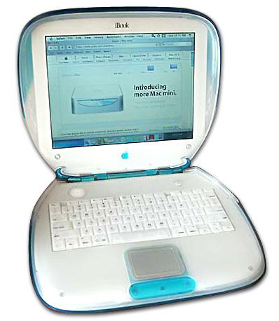
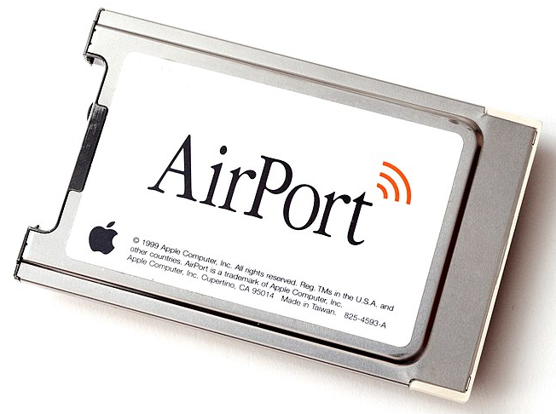
WiFi standard timeline
1985 – US FCC rules ISM band for unlicensed use
1990s – WaveLAN (NCR Corporation, Netherlands)
Wireless ethernet for cashier systems
1997 – 802.11 specification
1999 – 802.11b and 802.11a amendments
1999 – WiFi Alliance formed for certification of devices
1999 – Apple iBook is the first consumer WiFi product
Notes:
++ While we are deploying an enormously large number of IoT devices, I claim that very little attention is being paid to their energy challenge.
++ Today, most IoT devices are very energy expensive, and consequently, they rely on bulky batteries such as AA/AAA sized batteries for their operation. Even when operating on these batteries, they require frequent replacement of the exhausted batteries. This can be challenging when performed at a massive scale, especially considering that we may have a trillion embedded device deployed in the world.
++ Further, it can also harm the environment. These batteries use toxic chemicals, which means now we can have billions of toxic chemicals laden batteries that would be disposed of in landfills. This is especially important as sustainability has become an essential aspect across the world; in fact, imperial college was celebrating sustainability week.

Slide 10
Timeline of development of WiFi standard
 | Protocol | Year | Frequency | PHY | Max Rate | Range
- | 802.11 | 1997 | 2.4 GHz | DSSS/FHSS | 2 Mbps | 20 m
1 | 802.11b | 1999 | 2.4 GHz | DSSS | 11 Mbps | 35 m
2 | 802.11a | 1999 | 5 GHz | OFDM | 54 Mbps | 35 m
3 | 802.11g | 2003 | 2.4 GHz | OFDM | 54 Mbps | 38 m
4 | 802.11n | 2009 | 2.4/5 GHz | OFDM + MIMO | 600 Mbps | 70 m
5 | 802.11ac | 2013 | 5 GHz | OFDM + MU-MIMO [downlink only] | 3.4 Gbps | 35 m
6 | 802.11.ax | 2021 | 2.5/5 [/6] GHz | OFDMA + MU-MIMO | 9.6 Gbps | 35 m
Notes:
++ While we are deploying an enormously large number of IoT devices, I claim that very little attention is being paid to their energy challenge.
++ Today, most IoT devices are very energy expensive, and consequently, they rely on bulky batteries such as AA/AAA sized batteries for their operation. Even when operating on these batteries, they require frequent replacement of the exhausted batteries. This can be challenging when performed at a massive scale, especially considering that we may have a trillion embedded device deployed in the world.
++ Further, it can also harm the environment. These batteries use toxic chemicals, which means now we can have billions of toxic chemicals laden batteries that would be disposed of in landfills. This is especially important as sustainability has become an essential aspect across the world; in fact, imperial college was celebrating sustainability week.

Slide 11
Goal: improve throughput
In twenty years, WiFi has gone from 2 Mbps to 9.6 Gbps
How does a network PHY improve its throughput?
More capable modulation and/or bit transmission
Techniques like OFDM and MIMO
More bandwidth
Increased channel with at 2.4 Ghz and bigger 5 GHz channels

Slide 12
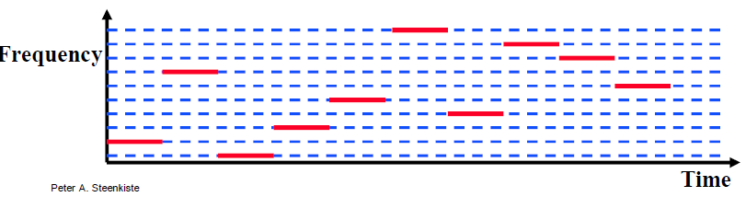
Original WiFi specification (1997)
Legacy WiFi
Frequency Hopping Spread Spectrum (FHSS)
GFSK (Gaussian Frequency-Shift Keying)
Relatively simple radio design
Frequency hopping over 80 channels (1 MHz each)

Slide 13
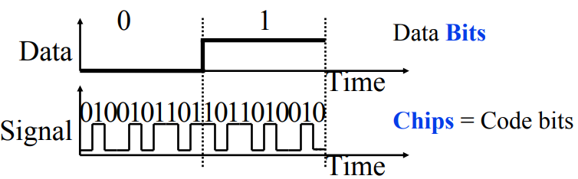
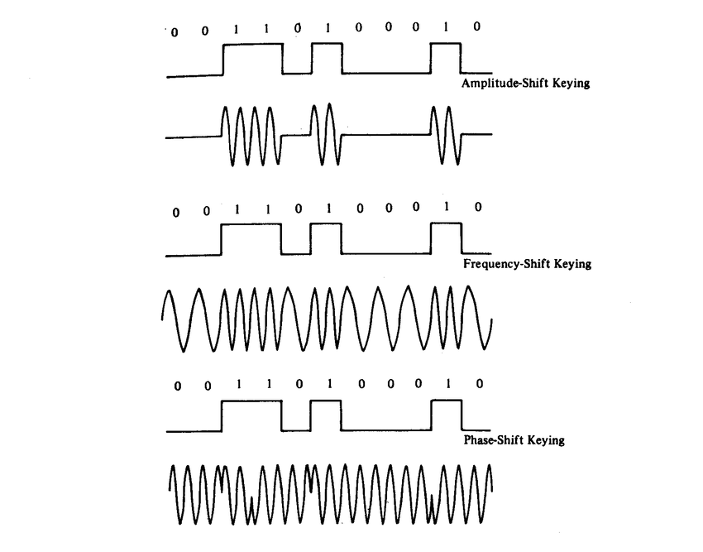
802.11b (1999)
802.11b
Direct Sequence Spread Spectrum (DSSS)
DBPSK and DQPSK (Differential Binary/Quadrature Phase-Shift Keying)
Translate data into “codes”
Each data bit corresponds to several code bits (Chips)
Chips are what is actually modulated over the air
Data can be recovered by knowing the code patterns
Modulation
Phase-shift Keying (of the Chips)

Slide 14
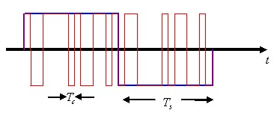
DSSS goals
DSSS increases bandwidth of a signal
Beyond what is needed for the data
Energy is smeared across the frequencies
More robust against interference
Data can be recovered from partial code
Cost: using a lot of bandwidth for only a little data

Slide 15
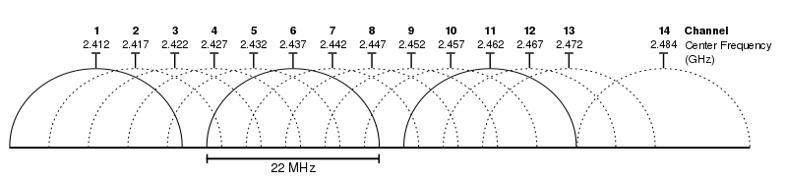
802.11b channels
14 channels total
1-11 for US
1-13 for most of the rest of the world
1-14 for Japan (but 14 only for 802.11b)
22 MHz channels
5 MHz spacing -> significant channel overlap
Channels 1, 6, and 11 can be used without overlap

Slide 16
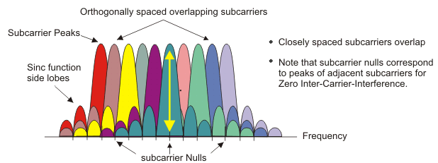
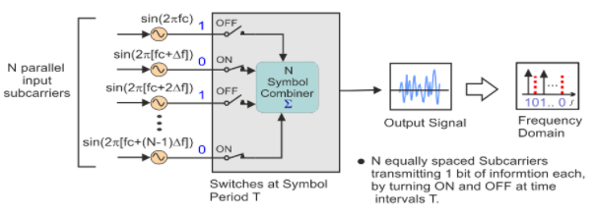
OFDM enables higher throughput
Replace DSSS with Orthogonal Frequency Division Multiplexing
OFDM idea
Split band into a number of narrow subcarriers
Subcarriers are spaced so that they don’t interfere
Transmit on multiple subcarriers at once to increase throughput
Recall DSSS

Slide 17
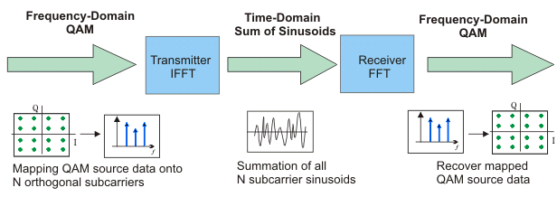
OFDM higher throughput at complexity cost
Receivers collect signal from entire channel
And then can split it apart to gain the data on each subcarrier
Tradeoffs
Benefits: more throughput, still robust against narrowband interference
Costs: more complicated and sensitive radio design

Slide 18
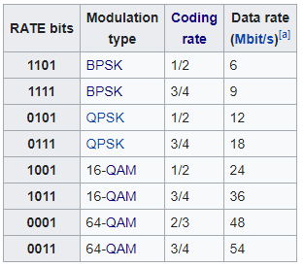
802.11a (1999)
Applied OFDM techniques on the 5 GHz band
Enabled more data throughput 54 Mbps (compare to 11 Mbps for 802.11b)
Multiple rates available
BPSK/QPSK/QAM over OFDM
Quadrature Amplitude Modulation (QAM)
Never reached widespread adoption
Regulatory hurdles in some regions
More complicated hardware delayed it

Slide 19
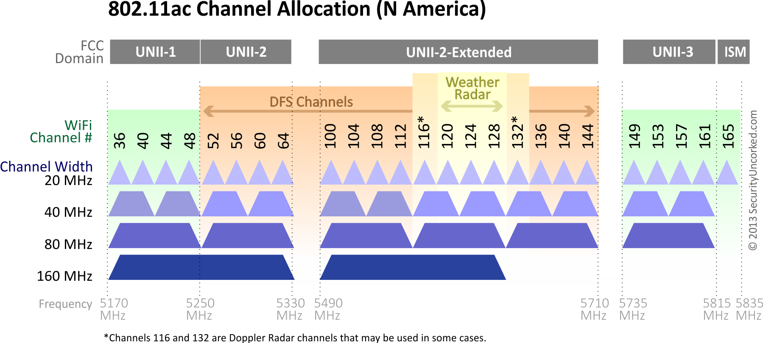
802.11a channels
802.11a did promote the use of 5 GHz band
Several 20 MHz channels with no overlap
Big increase from “three” channels of 2.4 GHz
Various regional rules on a number of different channels
Needs to avoid frequencies in use by existing radar deployments
Orange channels aren’t used, except for enterprise

Slide 20
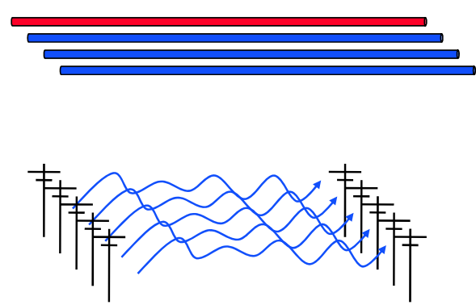
How do we increase throughput?
Wired world
Add more wires in parallel
Wireless world
Add more antennas?

Slide 21
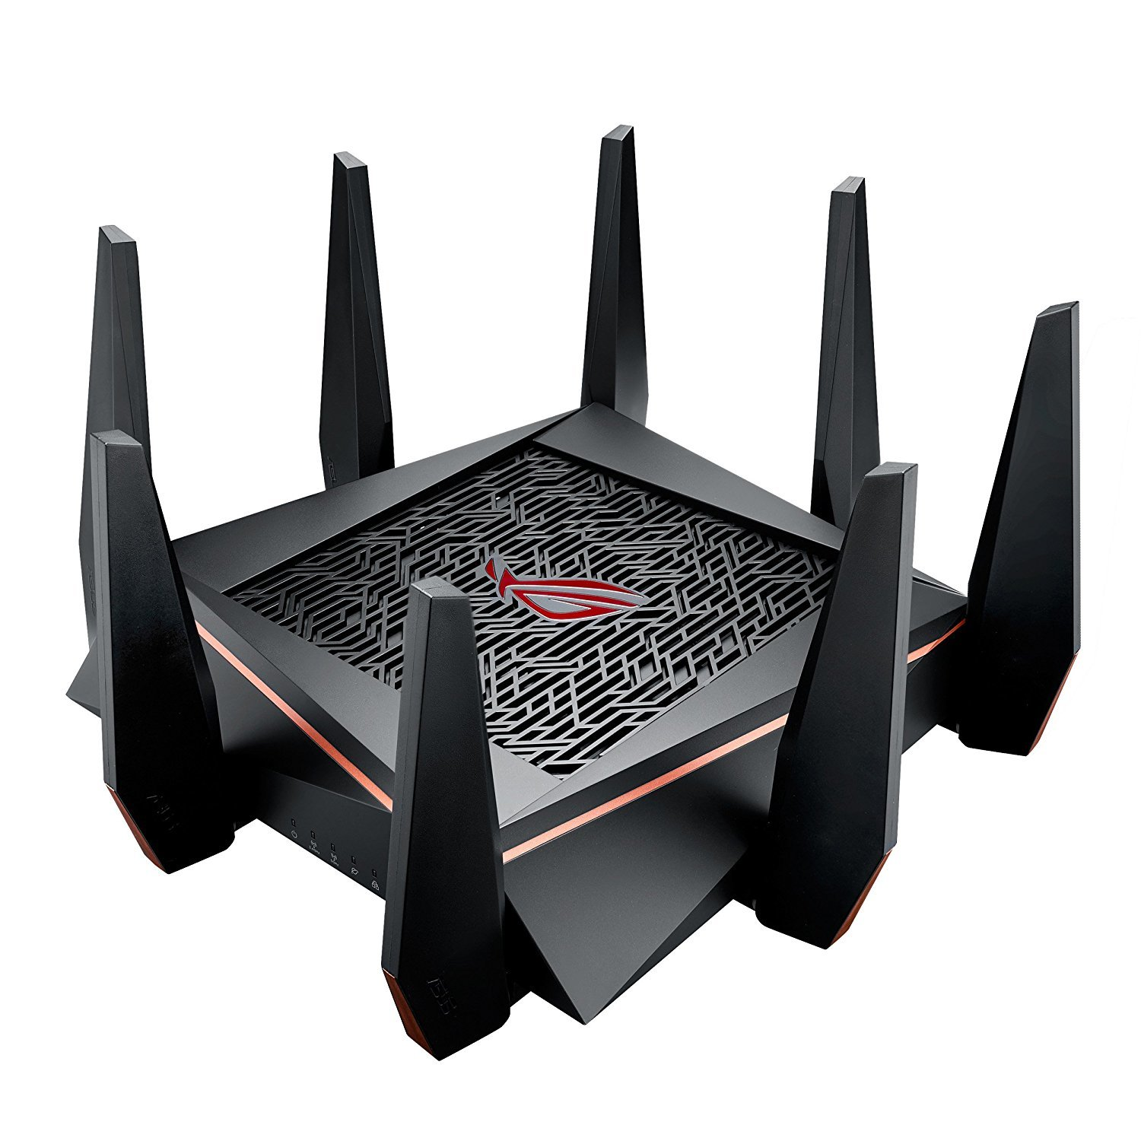
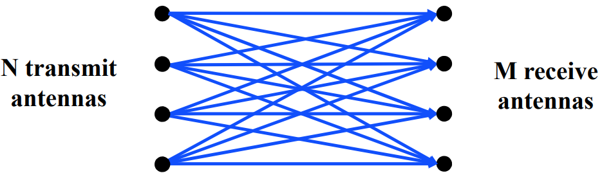
MIMO – Multiple In Multiple Out
N x M subchannels can be used to send data simultaneously
Huge boost in data throughput
Antenna diversity adds to reliability as well
The signals may interfere with each other
But receiving all of them allows the data to be recovered
Beamforming
Use interactions between array of antennas to focus energy on the receiver

Slide 22
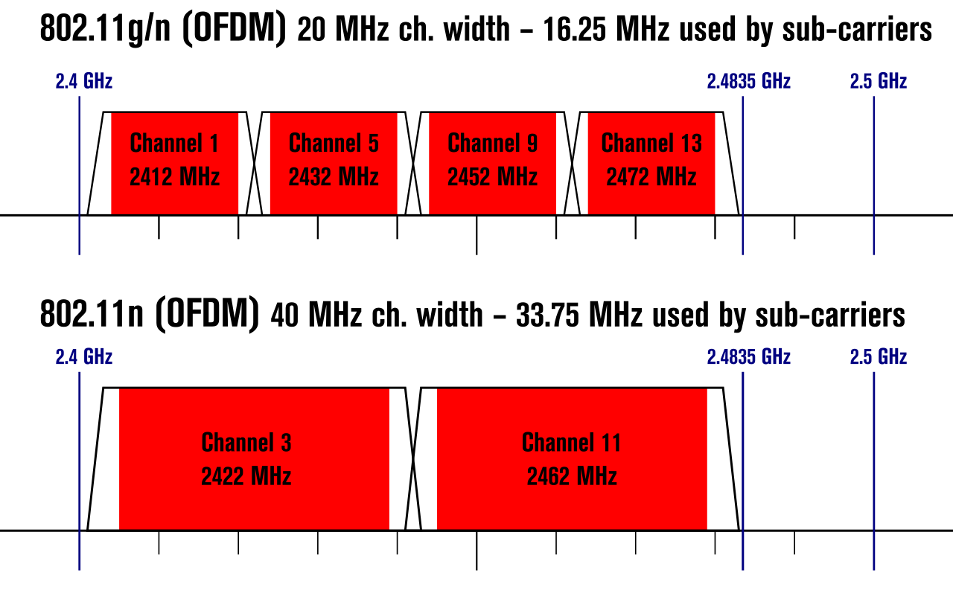
Expandable bandwidth
OFDM allows many subcarriers within a channel to be used at once
Throughput scales with the amount of bandwidth available
Allow larger 40 MHz channels to be used

Slide 23
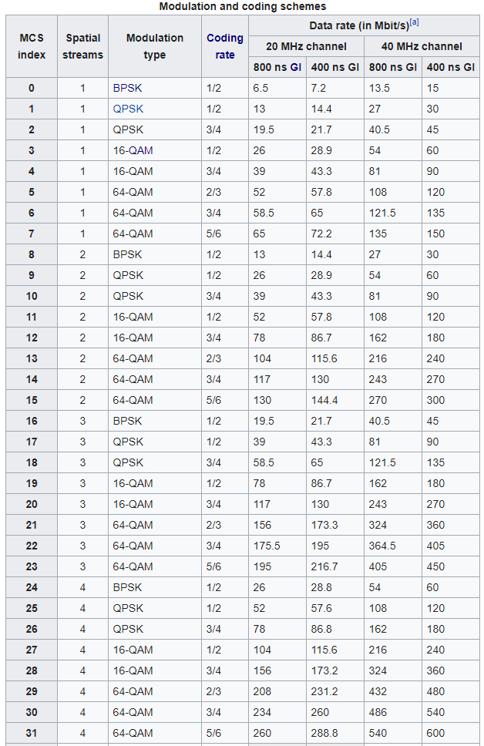
802.11n modulation and coding schemes
MCS – Modulation and Coding Scheme
GI – Guard Interval: delay between transmitted symbols

Slide 24
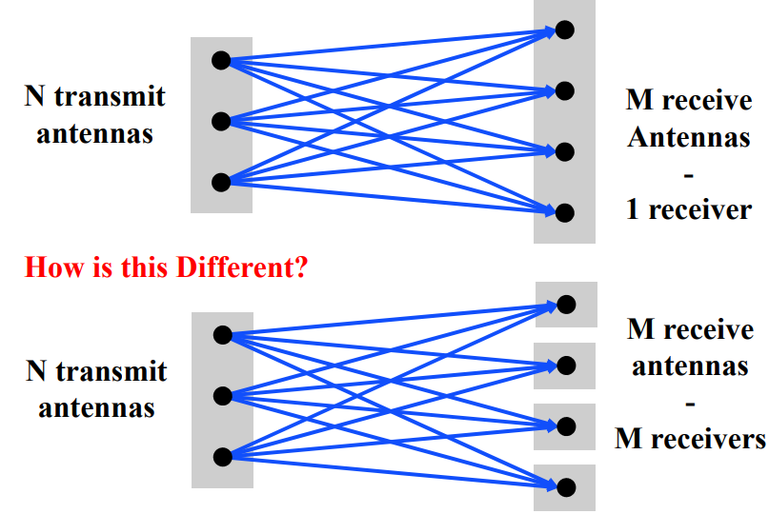
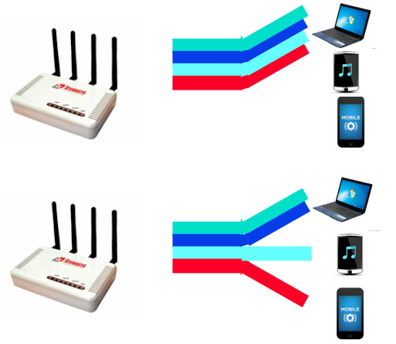
Multi-user Multiple In Multiple Out (MU-MIMO)
Multi-user MIMO uses the same techniques to send in parallel to multiple devices
Devices cannot cancel out interference anymore
Send slower, more reliable data streams to overcome this

Slide 25
802.11ac (2013)
Update for 5 GHz band only
Supports Downlink MU-MIMO (from AP to device)
Supports channels widths up to 160 MHz
Engineering updates: up to 256-QAM
Routers apply 802.11ac to 5 GHz and 802.11n to 2.4 GHz

Slide 26
802.11ac channels

Slide 27
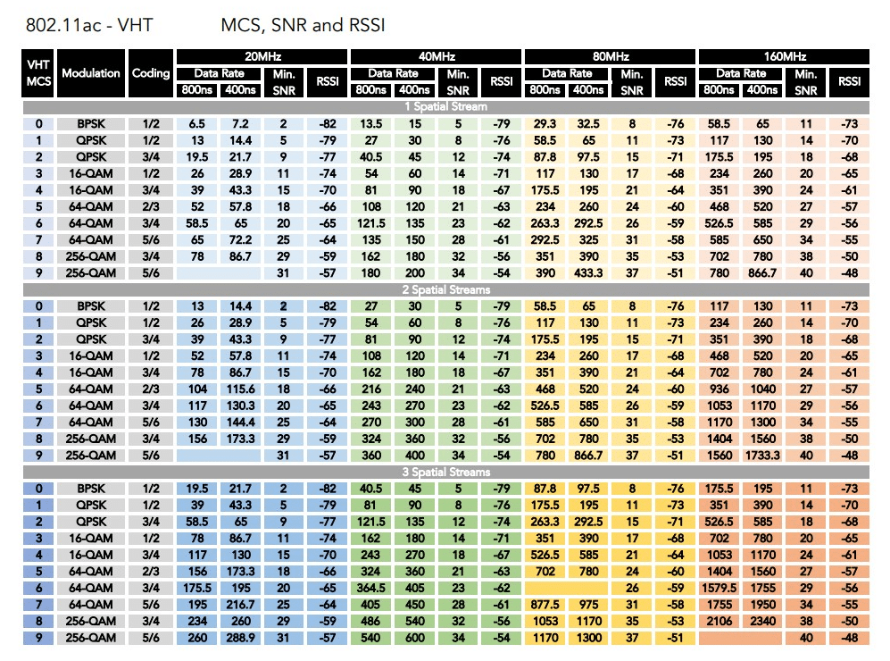
802.11ac modulation and coding schemes
4 spatial streams is also allowed, getting up to 3466 Mbps

Slide 28
New directions in WiFi focus: Aggregate throughput across all devices
For point-to-point, WiFi is “(more than) fast enough”
Now the problem is the quantity of devices in a single space
Desktop, laptop, tablet, smartphone, smartwatch, IoT devices, etc.
Insight: Bring established cellular techniques to WiFi

Slide 29
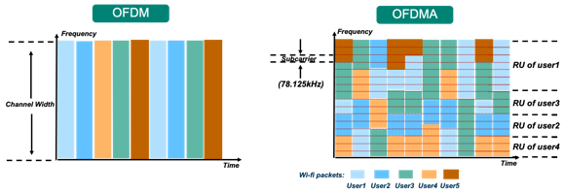
Orthogonal Frequency Division Multiple Access
OFDM: split channel into subcarriers and transmit on those
OFDMA: allocate subcarriers to a device for an amount of time
Turns OFDM into an access control mechanism
Complicated question: which device gets which subcarriers at which time?

Slide 30
802.11ax (2021)
Standard approved on February 9th 2021
First devices started supporting it in 2019 (WiFi 6)
6 GHz band (WiFi 6E)
1.2 GHz of bandwidth (5.925-7.125 GHz)
2020: US FCC made band available for unlicensed use!!!
EU is expected to follow in March 2021
OFDMA
MAC scheduling variant of OFDM
Schedule devices based on time and subcarrier allocations

Slide 31
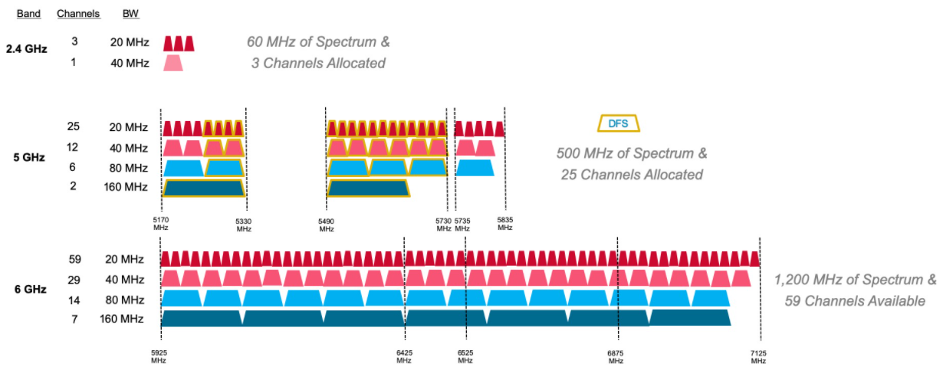
6 GHz band is an enormous amount of bandwidth

Slide 32
Learning Objective for Today’s Lecture
Review: last few lecture’s topics
Cellular Basics
1G
2G
3G
3GPP, 4G
5G
Cellular for IOT

Slide 33
Long-range,low-data needs are not easily met
WiFi
Data
Throughput
Range

Slide 34
Long-range,low-data needs are not easily met
WiFi
Data
Throughput
Bluetooth
BLE
Zigbee
Range

Slide 35
Long-range,low-data needs are not easily met
WiFi
Higher Power & Higher Cost
Data
Throughput
Bluetooth
BLE
Zigbee
Lower Power & Lower Cost
Range

Slide 36
Long-range,low-data needs are not easily met
WiFi
4G
Higher Power & Higher Cost
3G
Data
Throughput
2G
Bluetooth
2G
BLE
Zigbee
Lower Power & Lower Cost
Range

Slide 37
Long-range,low-data needs are not easily met
WiFi
4G
Higher Power & Higher Cost
3G
Data
Throughput
Bluetooth
2G
Low-Power Wide-Area Networks
BLE
Zigbee
Lower Power & Lower Cost
Range

Slide 38
The first commercial mobile phone was in 1946!
By 1948, 5000 users placing around 30,000 calls weekly
“The equipment, of course employing vacuum tubes, weighed eighty pounds, filled much of a vehicle’s trunk and drew so much power that it would cause the headlights to dim. Service cost $15 per month, plus thirty to forty cents per local call, equivalent to $175 2012 dollars, plus $3.50 to $4.65 per call. “
https://ethw.org/The_Foundations_of_Mobile_and_Cellular_Telephony
https://www.smithsonianmag.com/innovation/first-mobile-phone-call-was-made-75-years-ago-180978003/

Slide 39
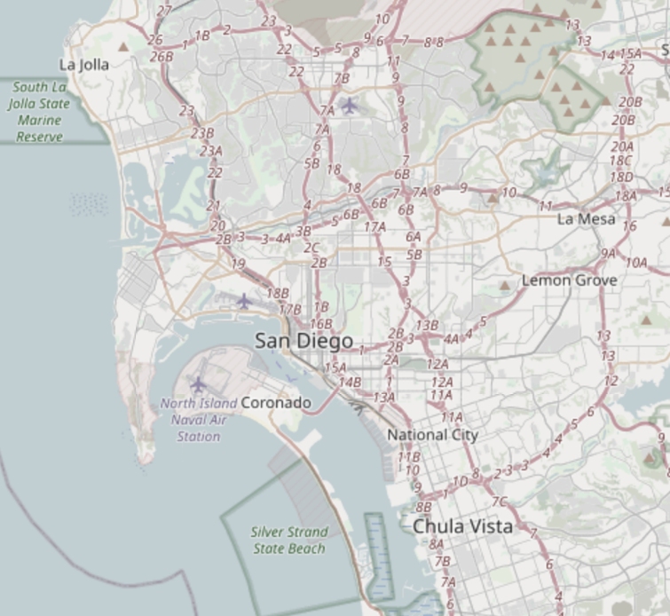
The first `mobile` network architecture
Single transmitter tower, multiple receiver towers
Why?
Medium Access Control?
Push-to-talk [half-duplex]
City-wide “party line”
Maximum of three concurrent callers
Notes:
A single transmitter on a central tower provided a handful of channels for an entire metropolitan area. Between one and eight receiver towers handled the call return signals. At most, three subscribers could make calls at one time in any city using the single transmitter and the tiny amount of spectrum allocated by the Federal Communications Commission to this service. It was in effect a massive party line, where a tightly controlled number of subscribers had to listen first for someone else on the line, and, if finding the line free, signal an operator, who would place the call. During the call, the user depressed a button on the handset to talk and released it to listen.

Slide 40
The first `mobile` network architecture
Single transmitter tower, multiple receiver towers
Why? Transmission energy of phone!
Medium Access Control?
Push-to-talk [half-duplex]
City-wide “party line”
Maximum of three concurrent callers
Notes:
A single transmitter on a central tower provided a handful of channels for an entire metropolitan area. Between one and eight receiver towers handled the call return signals. At most, three subscribers could make calls at one time in any city using the single transmitter and the tiny amount of spectrum allocated by the Federal Communications Commission to this service. It was in effect a massive party line, where a tightly controlled number of subscribers had to listen first for someone else on the line, and, if finding the line free, signal an operator, who would place the call. During the call, the user depressed a button on the handset to talk and released it to listen.

Slide 41
1965: The Improved Mobile Telephone Service
”More spectrum”
Bell: VHF Low (35-44 MHz, 9 channels), VHF High (152-158 MHz, 11 channels), UHF (454-460 MHz, 12 channels)
7 channels at VHF, and 12 channels at UHF for "RCCs" (Radio Common Carriers)
These will end up becoming pagers, mostly
“Full Duplex”
Implemented as channel pairs (two half-duplex)
Spectrum alone is not enough
Limited to 40,000 total subscribers
E.g. NYC had 2,000 people on 12 channels with a typical wait of 30 minutes to place a call
Phones fit in a briefcase now
Notes:
Also now full duplex, and no more operators

Slide 42
Quick review: How can we share spectrum?
Frequency division
Already doing that
Time division
Already doing that
Code division
Won’t come to [US…] mobile networks until the 80’s
Spatial division!!

Slide 43
What’s inefficient with this picture?
Early mobile networks handled the mobility challenge with wide-area coverage
The active user could be anywhere in the 40~60 mile range of the transmit tower
So they had exclusive access to that whole area!
12 frequency channels → 12 users

Slide 44
The `cell` in cellular networks
Cell is spatial division
Reduce transmit power, smaller area
Now…
12 / 3 = 4 channels per cell
* 6 cells in area
= 24 users of same spectrum!
And we can choose the cell size based on our expected needs

Slide 45
Spatial division tradeoffs
?
Need more infrastructure (more towers)
Need logic to support handoff
Cellular concept in Bell labs at 1947 [one year after mobile], but no handoff

Slide 46
How often does handoff need to happen anyway?
Really a question of “how big are cells”
A back-of-envelope answer for “Handoffs per 3-minute call”:
 | Speed (mph) | Speed (kph) | Cell Radius (km) | Handoffs
Freeway, rural | 65 | 104 | 16 | 0.33
Freeway, urban | 65 | 104 | 1.6 | 3.25
Surface streets, urban | 30 | 48 | 1 | 2.4
Pedestrian, urban | 1.5 | 2.4 | 1 | 0.12
Pedestrian, microcell | 1.5 | 2.4 | 0.1 | 1.2
Table data from Arthur H. M. Ross, PhD: http://www.cdg.org/technology/cdma_technology/a_ross/handoff.asp

Slide 47
Evolution of Cellular Wireless Network
First Generation Analog (AMPS)‏
Second Generation
TDMA
GSM (SingTel/M1, Europe, AT&T)‏
NA-TDMA IS-136 (AT&T)‏
CDMA (U.S.A.)‏
Third Generation
CDMA2000 (U.S.A.)‏
WCDMA (Europe, Singapore)‏
4G/5G Generation
LTE
Notes:
47

Slide 48
Learning Objective for Today’s Lecture
Review: last few lecture’s topics
Cellular Basics
1G
2G
3G
3GPP, 4G
5G
Cellular for IOT

Slide 49
First Generation Analog System
Example
Advanced Mobile Phone Service (AMPS)‏
Provide analog traffic channels
two 25-MHz bands allocated to AMPS
One for transmission from base to mobile unit
One for transmission from mobile unit to base
Developed in 1970s
Early deployment in 1980s
> 40 million users in 1997
Notes:
49

Slide 50
What were the design goals of AMPS?
High voice quality (near wire line)
Small coverage area (cell radius: 1-16 miles)
Frequency reuse planned in system design
Low power mobile (handheld) transmitters (4 watts or less)
Medium power base stations (10’s of watts)
Low blocking (2%) during busy hour
System capacity for 100,000 or more customers per city

Slide 51
What are the characteristics of AMPS?
Frequency range (different frequencies for uplink/downlink), 25 MHz in each direction
824 MHz ~ 849 MHz for mobile stations to transmit
869 MHz ~ 894 MHz for base station to transmit
Channel Bandwidth: 30kHz
Max number of channel = 25,000/30 = 833
Data rate: 10kbps
Spectral Efficiency: 10kbps / 30 kHz = 0.33 bps/Hz

Slide 52
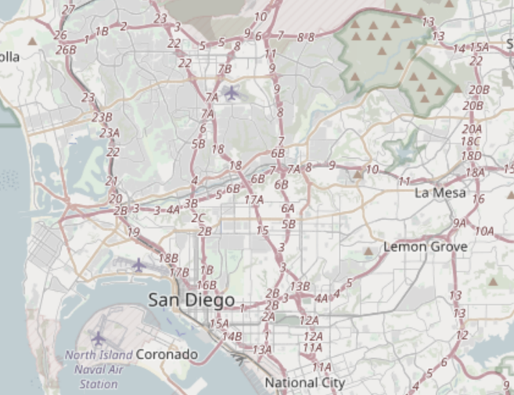
How does AMPS implement handoff?
Base station detects weak signal
Base station tells mobile about new, better tower
Base station sends cutover trigger

Slide 53
Over time, AMPS did also get more frequencies
AMPS in the US:
850 MHz band
Divided into “A” block and “B” block
Granted to local phone company and ‘wireless company’ respectively
Each block had 21 control, 395 voice channels
Several expansions of this frequency block
Most interesting, in 1989, UHF TV channels 70-83 added 666 more channels

Slide 54
Discontinuing 1G!
Single-user analog channels is not very efficient
Wireless carriers want to replace 1G
Key Takeaway: Spectrum allocation is the most scarce resource, therefore want to maximize efficiency of its use
But many things in the built environment rely on AMPS
Because when they were built, AMPS was the most reliable
OnStar
ADT home alarms [got sued!]
Some systems made adapters; others just stopped working
FCC required network support until early 2008
Notes:
Options: SOL mostly. People sold adapter kits to replace transmit modules where possible [see 2G OnStar example for this happening now later in slides]. ADT got sued class-action for selling products that were ‘destined to fail’ (suit failed).

Slide 55
Learning Objective for Today’s Lecture
Review: last few lecture’s topics
Cellular Basics
1G
2G
3G
3GPP, 4G
5G
Cellular for IOT

Slide 56
Spatial division in practice
Directional antennas at tessellation corners provide redundant coverage [robustness!]

Slide 57
Spatial division in practice
Directional isolation is imperfect, requires many bands in practice

Slide 58
Moving to 2nd Generation Systems
Introduced in the early 1990s
Digital traffic channels
improve spectrum efficiency, increase capacity by operating with smaller cells
Error detection and correction – digital transmission allows for the use of modern error detection and correction techniques
first-generation systems are almost purely analog;

Slide 59
Moving to 2nd Generation Systems
Encryption – all second-generation systems provide robust network security technology based on encryption and secure key distribution encryption to prevent eavesdropping
AMPS authentication procedures are weak
Roaming
Requires information transfer and business arrangement between systems, introduce IS-41
Support for non-voice services

Slide 60
IS-54 aka 2G aka TDMA aka D-AMPS (Digital AMPS)
Deployed ~1993
Used TDMA to share AMPS channels
Each AMPS analog channel-pair was 30 kHz
Digital compression allowed for 3 time slots per channel — tripled capacity!
Later iterations would compress further, 6 time slots per channel
Beat out competing FDMA analog solution from Motorola
Narrowband AMPS, “N-AMPS”, compressed calls to fit in 10 kHz channels
Also encrypted [poorly: CMEA broken publicly in 1997]

Slide 61
GSM
Modern 2G “GSM”?
“Global System for Mobile Communications”
It is a standard [the dominant 2G]
GSM meant “phone” for a while in parts of Europe
GSMA is the GSM Association; which a lot of people just call GSM
Because GSM made [a] 3G and LTE [which is a 4g?] and 5g [ish! more next time]

Slide 62
https://en.wikipedia.org/wiki/File:Gsm_structures.svg

Slide 63
GSM (Timing) Summary
Bit Period: 3.692ms (270.833 kbps)
Time Slot (TS): 576.92ms (156.25 bits)
Frame: 4.615ms (8 TS per frame)
Multiframe: 24 data + 2 control frame every 120ms
Traffic channels:
Full Rate: 22.8kbps, with forward error correction (FEC) - 9600 bps, 4800 bps, 2400 bps
Half Rate: 11.4kbps, with FEC - 4800 bps, 2400 bps
Control Channels

Slide 64
GSM Short Message Service
Short Message Service (SMS) provides a connectionless transfer of messages with low capacity and long latency performance
Each short message can contain up to 140 octets (or 160 7- bit characters)‏
Messages are transported on the GSM SDCCH signaling channels
Two types of SMS have been defined:
Cell broadcast service
Point-to-point service
Notes:
64

Slide 65
GSM evolved over time to add data
GSM was voice-only at first
Then overlaid data on the voice channel
Circuit Switched Data (CSD)
9.6 — 14.4 kb/s
Previous hacks were literally cell phone calling a modem (~3.5 kb/s); same concept
Then added actual packetized data [“2.5G”]
General Packet Radio Service (GPRS)
Throughput 9.2 – 21.55 kbit/s/timeslot [goodput 8-20 kbit/s/timeslot]
Enhanced Data Rates for GSM Evolution (EDGE)

Slide 66
Learning Objective for Today’s Lecture
Review: last few lecture’s topics
Cellular Basics
1G
2G
3G
3GPP, 4G
5G
Cellular for IOT

Slide 67
Moving to 3G Systems
Provides high-speed wireless communication for multimedia
Voice: quality comparable to PSTN
Data: 144kpbs for high-speed user (driving), 384kpbs for slowly moving user (walking) and 2.048Mbps for stationary user
2.5G Systems
GPRS/EDGE (GSM)‏
Notes:
67

Slide 68
3G Systems and beyond
CDMA-based 3G systems more widely accepted
CDMA 2000 in US
UMTS in Europe
3.5G Systems
HSPA
Moving from circuit-based to packet-based
Fourth Generation – ITU specifications:
target peak data rates of up to 100 Mbit/s for high mobility, 1 Gbit/s for low mobility
Notes:
68

Slide 69
Learning Objective for Today’s Lecture
Review: last few lecture’s topics
Cellular Basics
1G
2G
3G
3GPP, 4G
5G
Cellular for IOT

Slide 70
3GPP Long Term Evolution (LTE)
CDMA spread spectrum radio technology used in 3G is replaced by frequency-domain equalization schemes, for example multi-carrier transmission such as OFDMA
Include other techniques such as MIMO (i.e. multiple antennas (Multiple In Multiple Out)), dynamic channel allocation and channel-dependent scheduling

Slide 71
3GPP
3rd Generation Partnership Project (3GPP)
Industry alliance for development of telecoms standards
Established around 1998
Makes “Releases” which are roughly analogous to IEEE standards/versions
Release 8 (2008) LTE ~4G
Release 15 (2018) NR (New Radio) ~5G
Focused on the practical
ITU post-hoc defined “4G”, 3GPP defined LTE and LTE_________

Slide 72
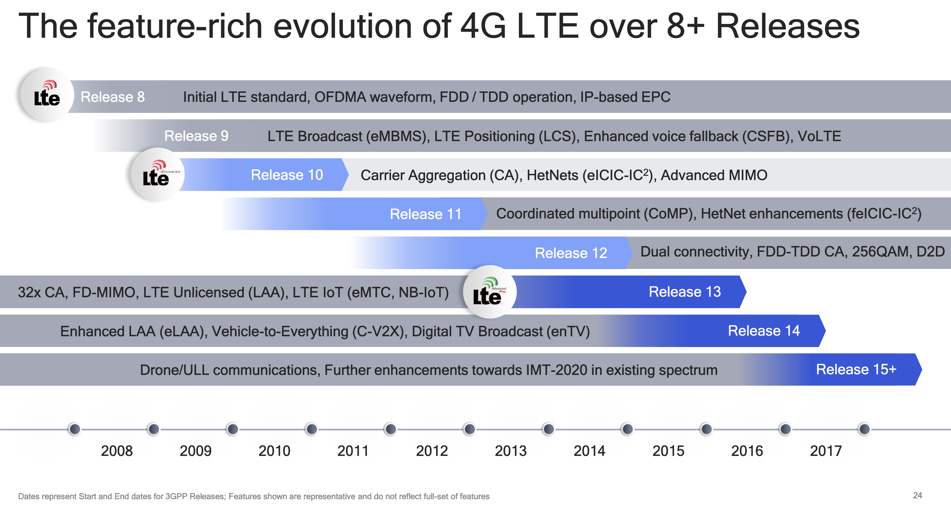
Mapping ”4G”, “LTE”, “LTE Advanced”, etc onto actual technologies
This Qualcomm presentation is great: https://www.qualcomm.com/media/documents/files/demystifying-3gpp-and-the-essential-role-of-qualcomm-in-leading-the-expansion-of-the-mobile-ecosystem.pdf

Slide 73
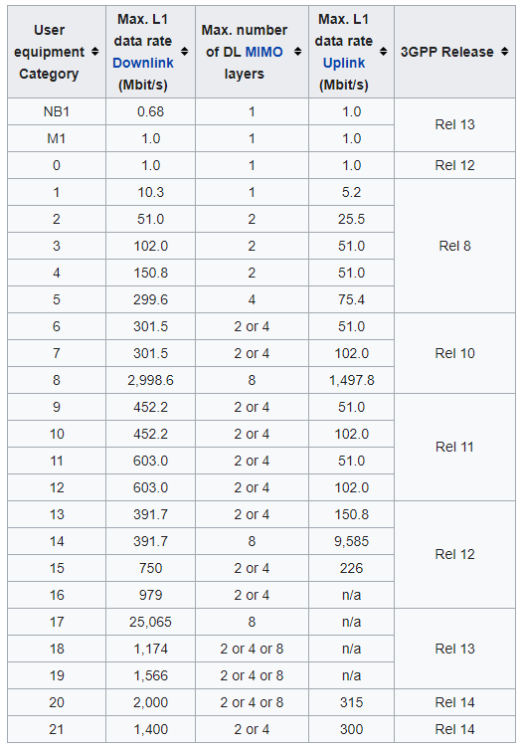
LTE Categories
Different equipment supports different “categories” of LTE
Maximum MCS index supported
Examples
iPhone 6 (2015): Cat 4
Pixel 3 (2018): Cat 16
Notes:
MCS = Modulation Coding Scheme
https://mcsindex.com/ looks like all the tables for WiFi; not clear whether this is the same for cell

Slide 74
Different LTE Releases
Release 8 (2008)
Peak Rate: downlink 300 Mb/s, uplink 75 Mb/s
a one-way radio-network delay of less than 5ms
Release 9 (2009)
Support for broadcast/multicast services, positioning services, and enhanced emergency-call functionality
Release 10 and beyond – LTE Advanced

Slide 75
Different LTE Releases

Slide 76
Learning Objective for Today’s Lecture
Review: last few lecture’s topics
Cellular Basics
1G
2G
3G
3GPP, 4G
5G
Cellular for IOT

Slide 77
5G
3GPP Release 15 is “5G phase 1” and is frozen March 2019
3GPP Release 16 will be "5G phase 2" and is frozen July 2020
3GPP Release 17 on-going, expected completion mid 2022

Slide 78
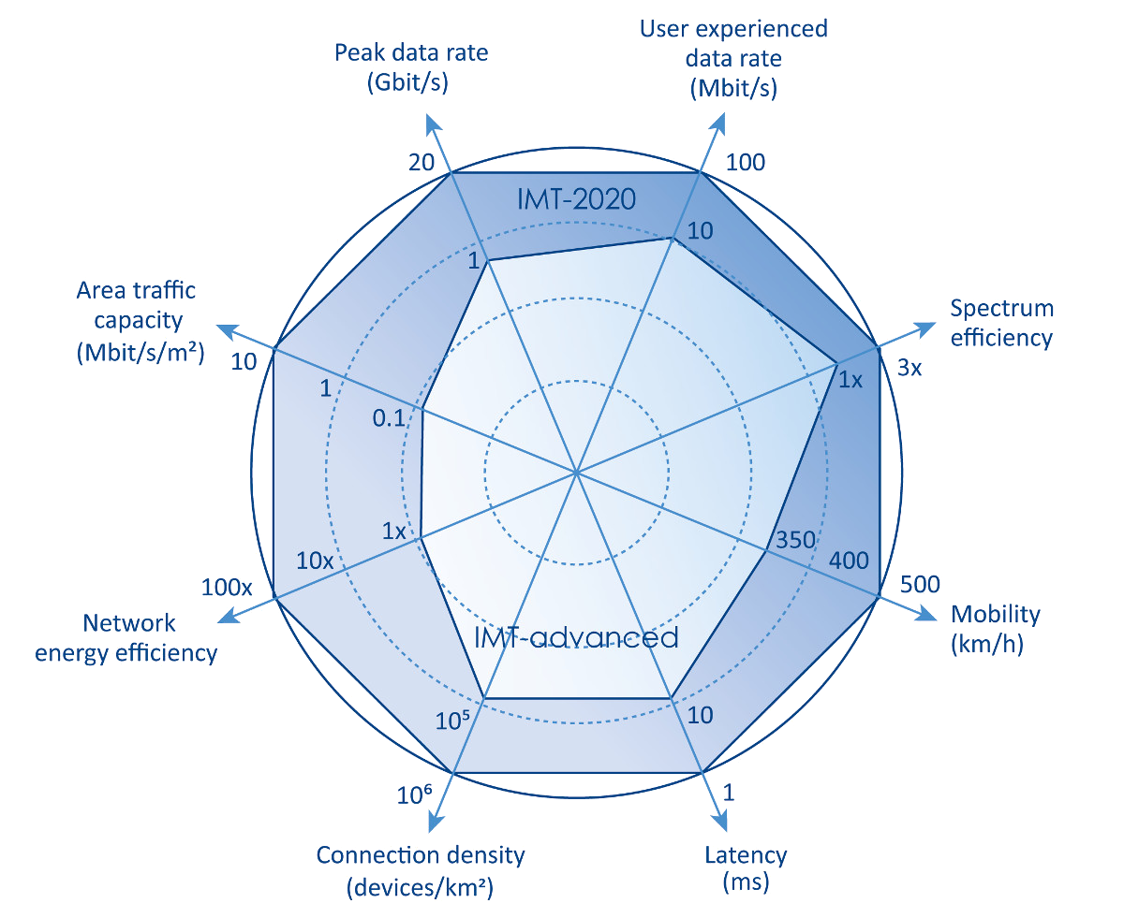
5G
https://www.etsi.org/technologies/5g

Slide 79
What is new in 5G?
Technology
new use cases
mmWave
massive MIMO
programmable hardware and network
cloud-based operation/management and orchestration
Architecture/Design
less proprietary hardware/software solutions
more COTS hardware
open-source software
interoperability between different vendors and operators
open source APIs for 3rd party apps

Slide 80
So what is 5G doing differently?
Largely, 5G is a small(er)-cell technology
“Urban optimized”
This does also allow for higher performance

Slide 81
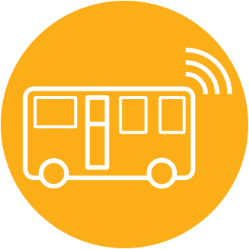
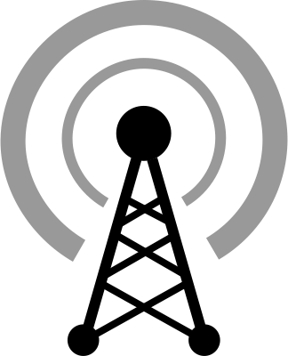

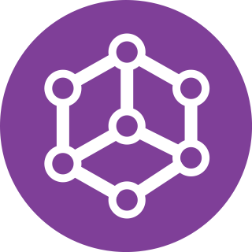

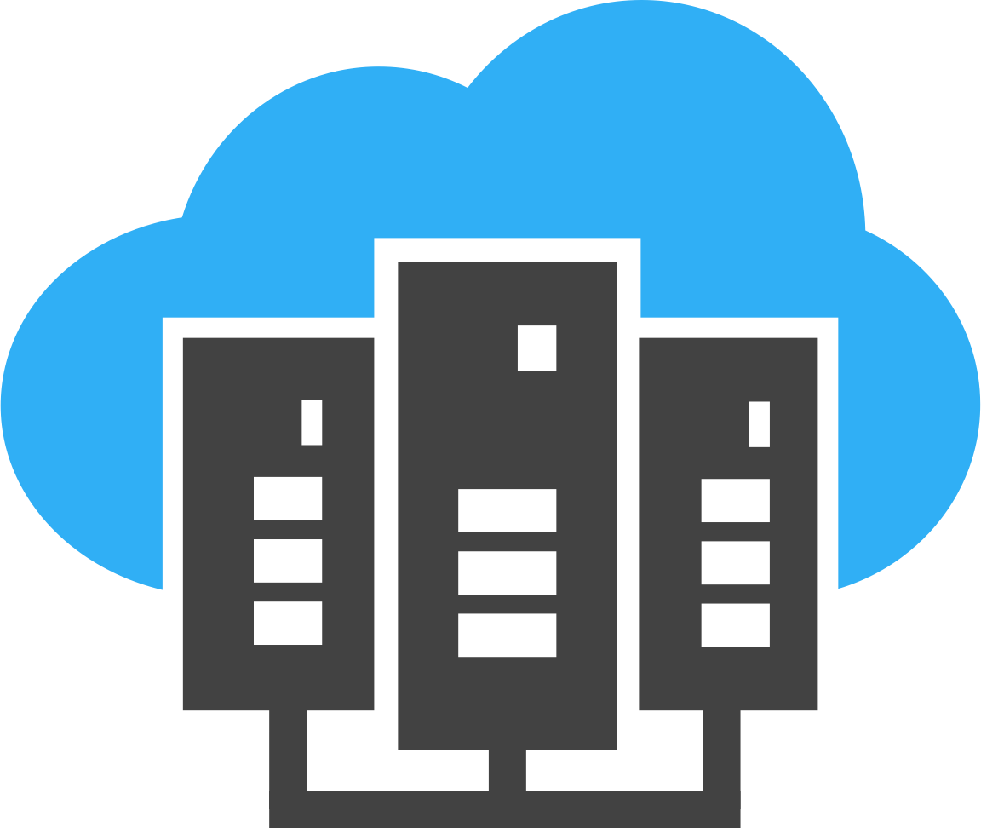
5G Architecture
Radio Access
Network
Frontend
Fronthaul
Backhaul
Core Network
Host/Server
1
Internet
Host/Server
Host/Server
2

Slide 82
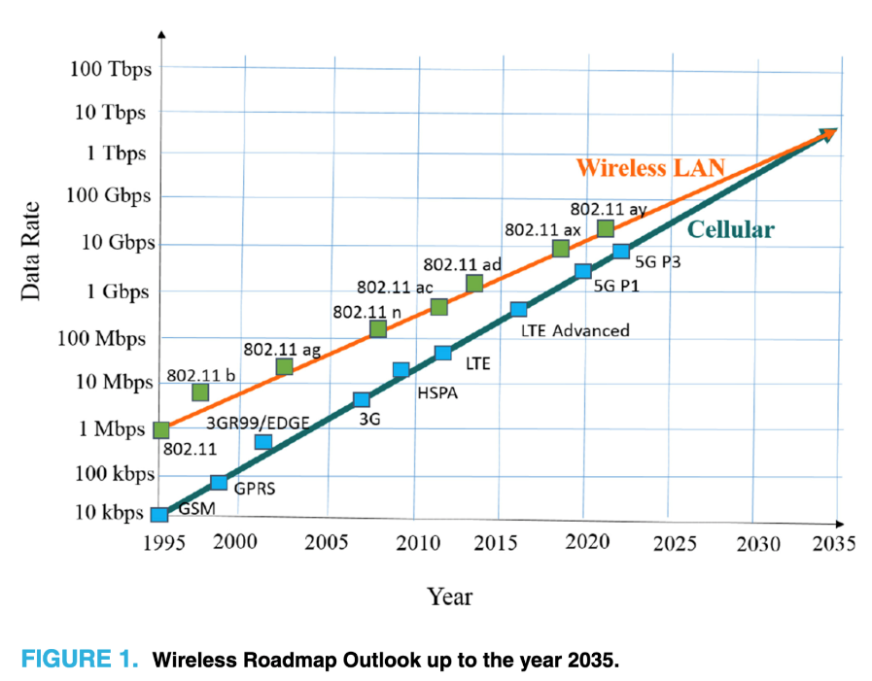
So what did [*]G provide over 2G anyway?
Biggest thing is throughput
And a spectrum land-grab
Wireless providers advocated [successfully] for [global] release of additional spectrum to support new, faster wireless
Lots of [initial] 4G rollout also on new spectrum
But no more coming — sunsets only way to get more 4G spectrum
5G is [mostly] on much higher bands, not suited for 4G
Terahertz Band: The Last Piece of RF Spectrum Puzzle for Communication Systems (preprint; Elayan et al.)

Slide 83
Learning Objective for Today’s Lecture
Review: last few lecture’s topics
Cellular Basics
1G
2G
3G
3GPP, 4G
5G
Cellular for IOT

Slide 84
So why does the IoT care about 2G?
It’s easy
2G == GMSK, 3G = QPSK [requires linear PA], 4G = …
It’s cheap
Relative to other cellular plans, anyways
It’s low power*
*For select IoT workloads
Energy-per-bit of continuous stream improves each generation
Energy-per-event of infrequent events…

Slide 85
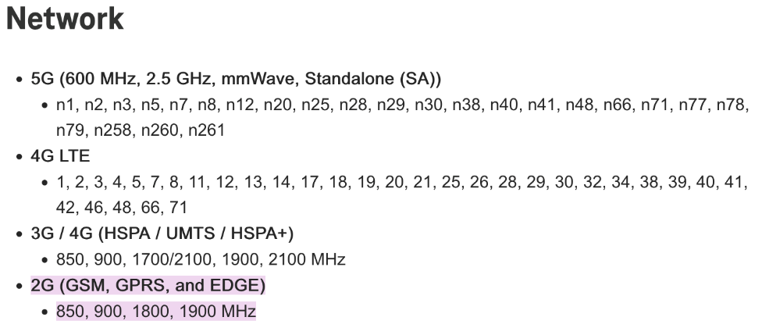
Why might 2G continue to survive [globally]?
More coverage for lower costs
2G has longer range than 3G
It fills the legacy niche
High performance HW includes fallbacks
2G/3G radios, then 2G/3G/4G radios, now 2G/3G/4G/5G radios
Consider the iPhone 13 Pro (2021)

Slide 86
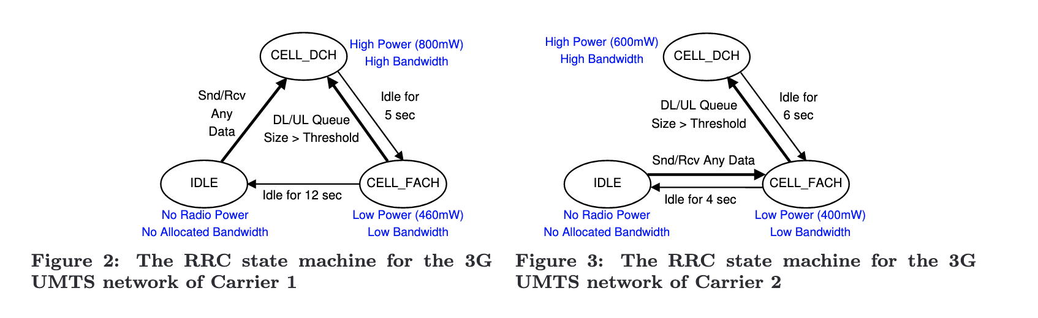
But energy per transaction is complex
Radios, cellular protocols, and cellular providers have state machines
Hard to predict a priori and globally ☹
Characterizing radio resource allocation for 3G networks; Feng Qian, Zhaoguang Wang, Alexandre Gerber, Zhuoqing Morley Mao, Subhabrata Sen, Oliver Spatscheck; SIGCOMM’10

Slide 87
Additional low-end categories for IoT
LTE Cat 0
Traditional LTE, but focused on the really low end
LTE-M (LTE Cat M1)
375 kbps uplink, 300 kbps downlink (for the actually implemented mode)
Reduced power and maximum bandwidth
Increased range
NB-IoT (LTE Cat NB1)
65 kbps uplink, 26 kbps downlink
Reduced power and greatly reduced bandwidth
Greatly increased range

Slide 88
Why do we need “special categories” for IoT on cell?
Pragmatic for the end device
Lower power
Allow for long-off periods
Pragmatic for network operators
Allows for scale– network no longer needs to assume that devices could always be on in each cell

Slide 89
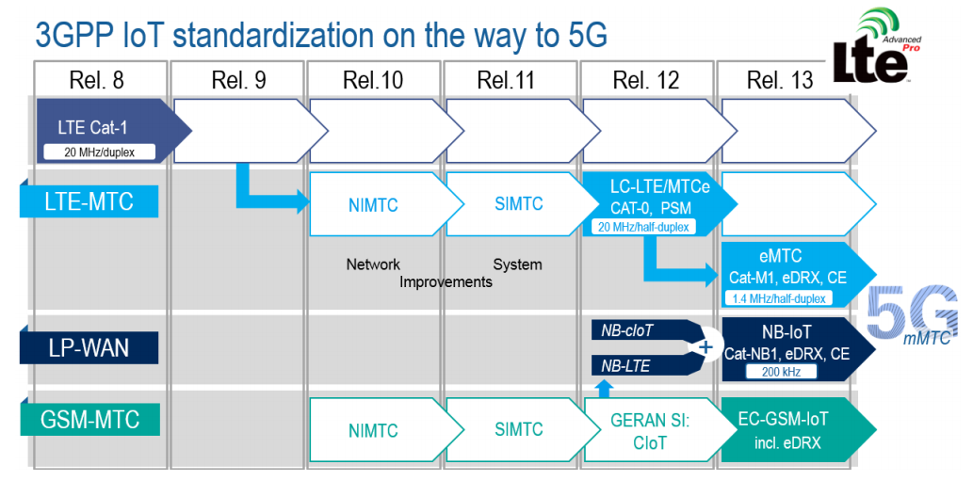
LTE-M and NB-IoT were developed in parallel

Slide 90
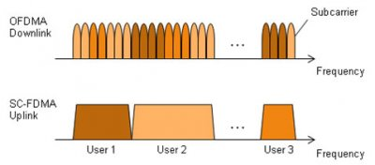
LTE-M and NB-IoT downlink and uplink
OFDMA downlink
Put the more complicated hardware in the cell tower [simple FFT demodulator]
SC-FDMA (single carrier FDMA) uplink
Blocks of subchannels combined into one signal
Similar concept, but simpler for end devices to implement

Slide 91
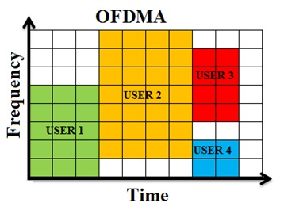
LTE resource allocation
Cellular uses OFDMA to schedule
Time + Frequency -> “2D Scheduling”
Cellular uses single channels up to 20 MHz
Further divides these into 100 Resource Blocks
Resource Block
12 subcarriers for OFDM in frequency (15 kHz each)
7 symbols in time (0.5 ms)
Devices are allocated frequency and time based on what they are sending
Allocated in units of Resource Blocks
One “Resource Block”

Slide 92
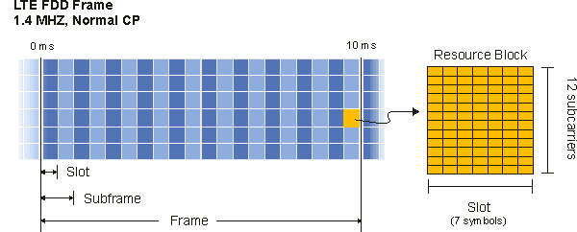
Resources used by LTE-M and NB-IoT
LTE-M uses up to 6 resource blocks
1.4 MHz of bandwidth (1.080 MHz)
Can co-exist with other normal LTE traffic, scheduled by cell tower
Limited to only some capability of LTE (much less throughput)

Slide 93
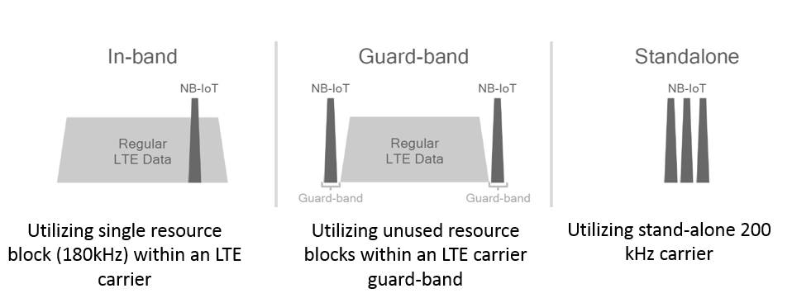
Resources used by LTE-M and NB-IoT
NB-IoT uses up to 1 resource block
200 kHz of bandwidth (180 kHz)
Multiple deployment options
Guard-band in practice

Slide 94
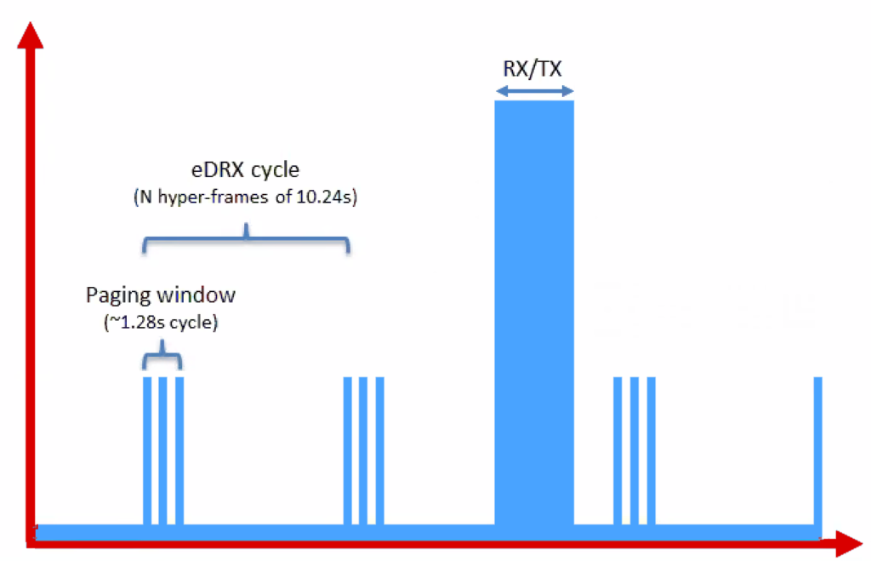
Reducing power for IoT devices
Reduce max Tx power to 20 dBm
Increased receive sensitivity at tower will cover it
Extended Discontinuous Reception (eDRX)
Allow devices to reduce paging period and still stay on network
Cell tower will hold messages
What does this get to?
“For a LTE-M1 device that transmits data once per day, and wakes up every 60 hyper frames to check for commands (this would be about every 10 minutes), a life of 4.7 years is achievable on 2 AA batteries.”
Graphics, quote from https://www.link-labs.com/blog/lte-e-drx-psm-explained-for-lte-m1

Slide 95
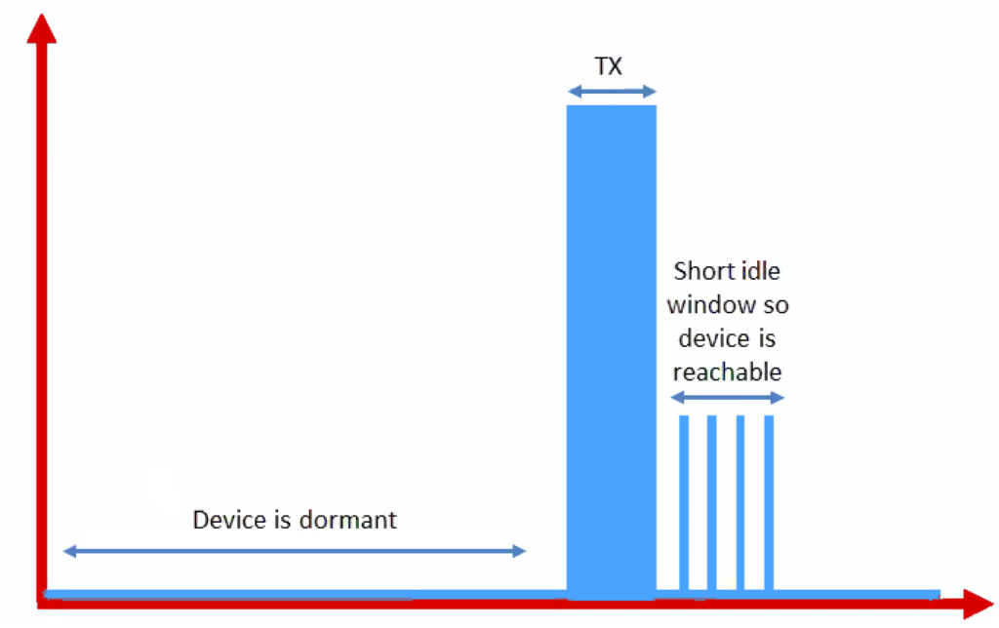
Further power reduction for simple devices
Power Saving Mode (PSM)
For very simple, uplink-focused devices, allow them to turn off entirely but stay connected
Minutes to days in duration
Notify tower before sleeping, listen for packets after each transmission
Graphics from https://www.link-labs.com/blog/lte-e-drx-psm-explained-for-lte-m1

Slide 96
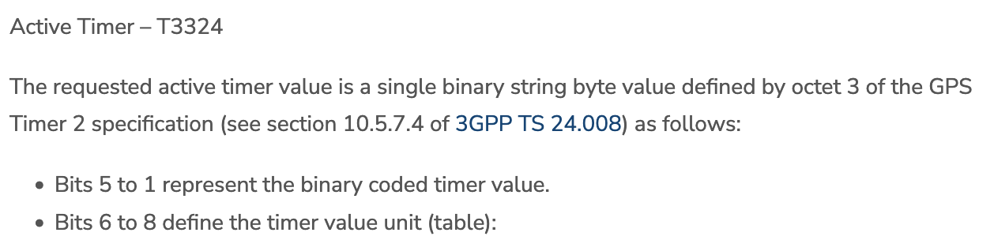
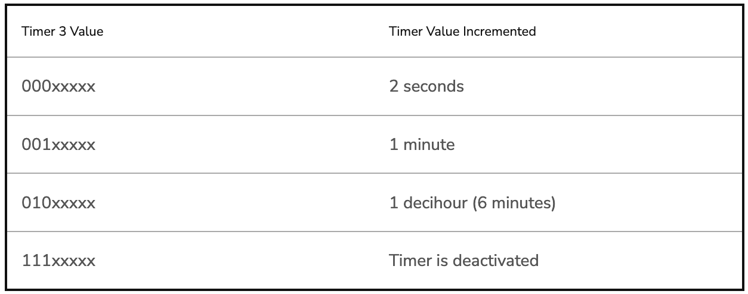
Some numbers from an actual telecom: Aeris [n.b. Aeris has been a leader in cellular M2M since the 90’s]
PSM has two timers, devices request values, tower chooses actual:
Extended Timer (“sleep” timer)
3GPP max is 35,712,00s [413.33 days]
Aeris timer range: Min 240m [4h]; Max 413 days
“Aeris Fusion” timer range: Max: 12.9 days
Active Timer (how long will the device stay in idle after communication?)
Numbers from https://aeriscom.zendesk.com/hc/en-us/articles/360049848254-Understanding-LTE-M-Power-Management-Modes
Notes:
Really hard to tell difference between Aeris and Aeris Fusion. I think Aeris Fusion is a new product that allows devices (same SIM?) to dynamically switch between an IoT profile and a full-fledge voice / high-bw data profile. My guess then is that Aeris network is all their own owned infra, and Fusion is them acting as an MVNO [thus limited to others for wakeup range]

Slide 97
Improved range for LTE-M and NB-IoT
LTE defines a Maximum Coupling Loss (MCL) a.k.a Link Budget
Traditional cellular: 144 dB (~2.5 km)
LTE-M: 160 dB (~5 km)
NB-IoT: 164 dB (~10 km)
Sigfox: ~155 dB
LoRaWAN: ~143 dB
Note that many cellular bands are often on higher frequencies
Example: 1900 GHz

Slide 98
Coarsely, lower frequency -> longer range
This was the picture circa 2019

Slide 99
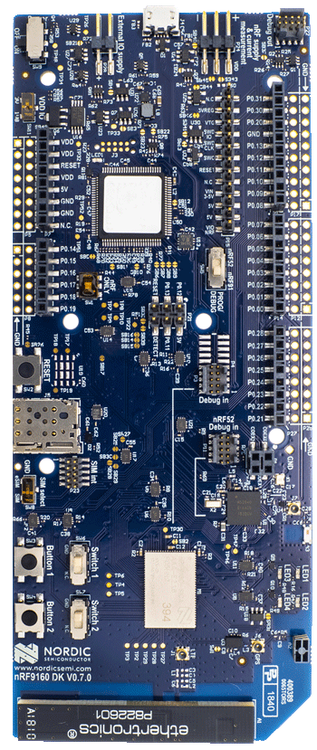
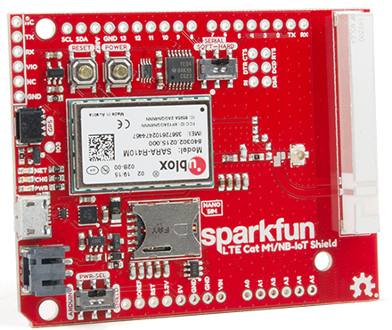
Microcontroller support
Devices need to be certified
Hardware and software
Tend to be modules or dual-core systems
Add a SIM card to connect to network

Slide 100
(END OF LECTURES)

Slide 101
Wireless Networking
Ambuj Varshney
Assistant Professor, National University of Singapore
Wireless, Embedded Intelligence, Sensing, and Emerging Technologies Group
ambujv@nus.edu.sg

